Slide 1
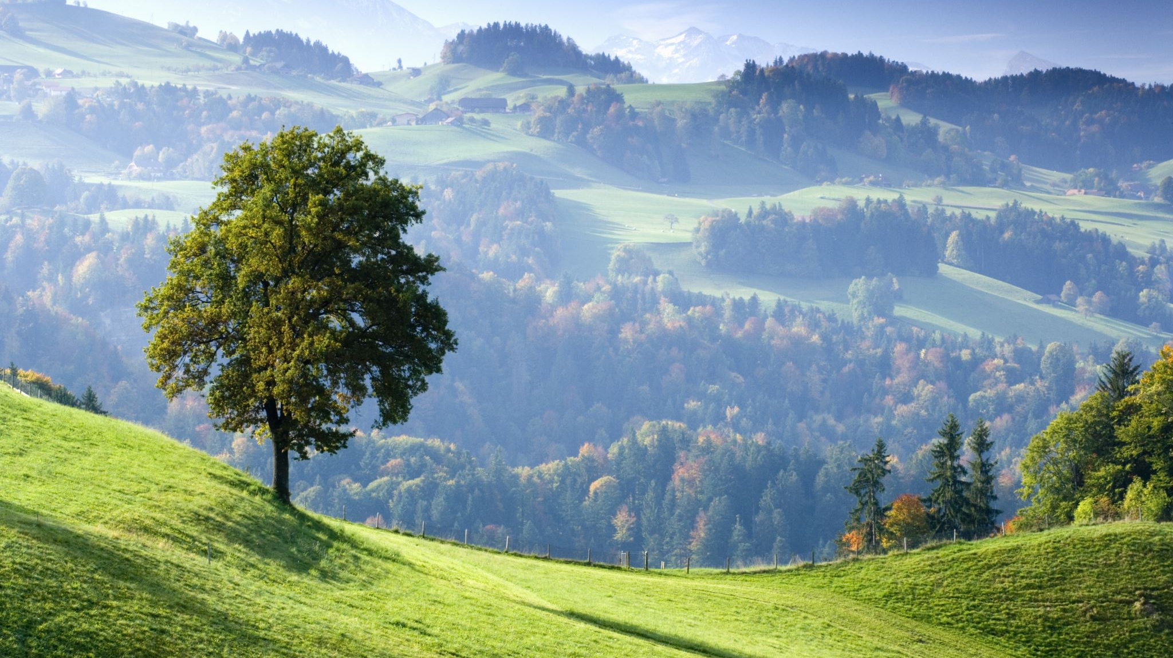
Cycle of Seasons
Ankur Garg (102003473)
Sarthak Narang(102003627)
Vishvam Salwan(102003646)

Slide 2
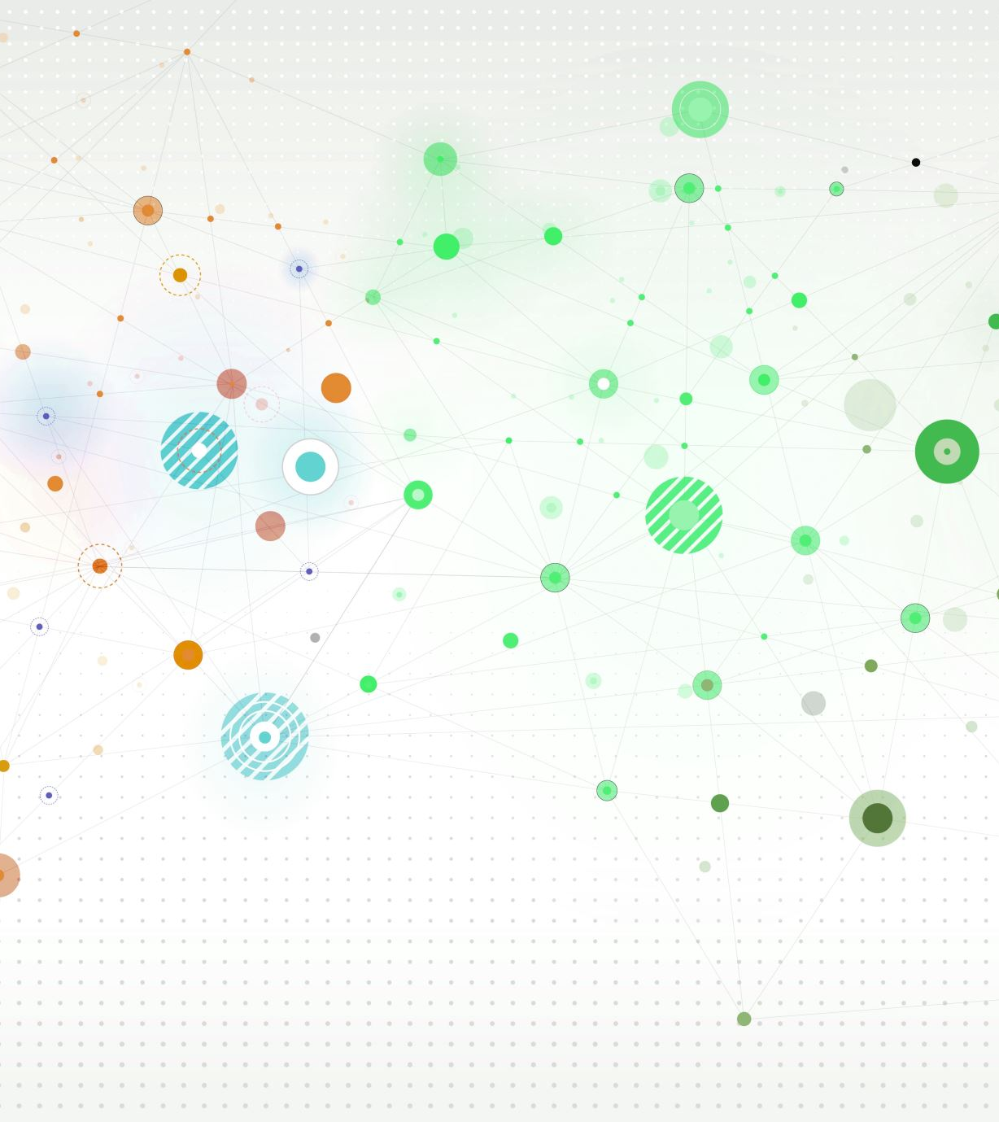
Table of Contents
About the Project​
Novelty
Concepts Used
​User defined functions
Screenshots

Slide 3
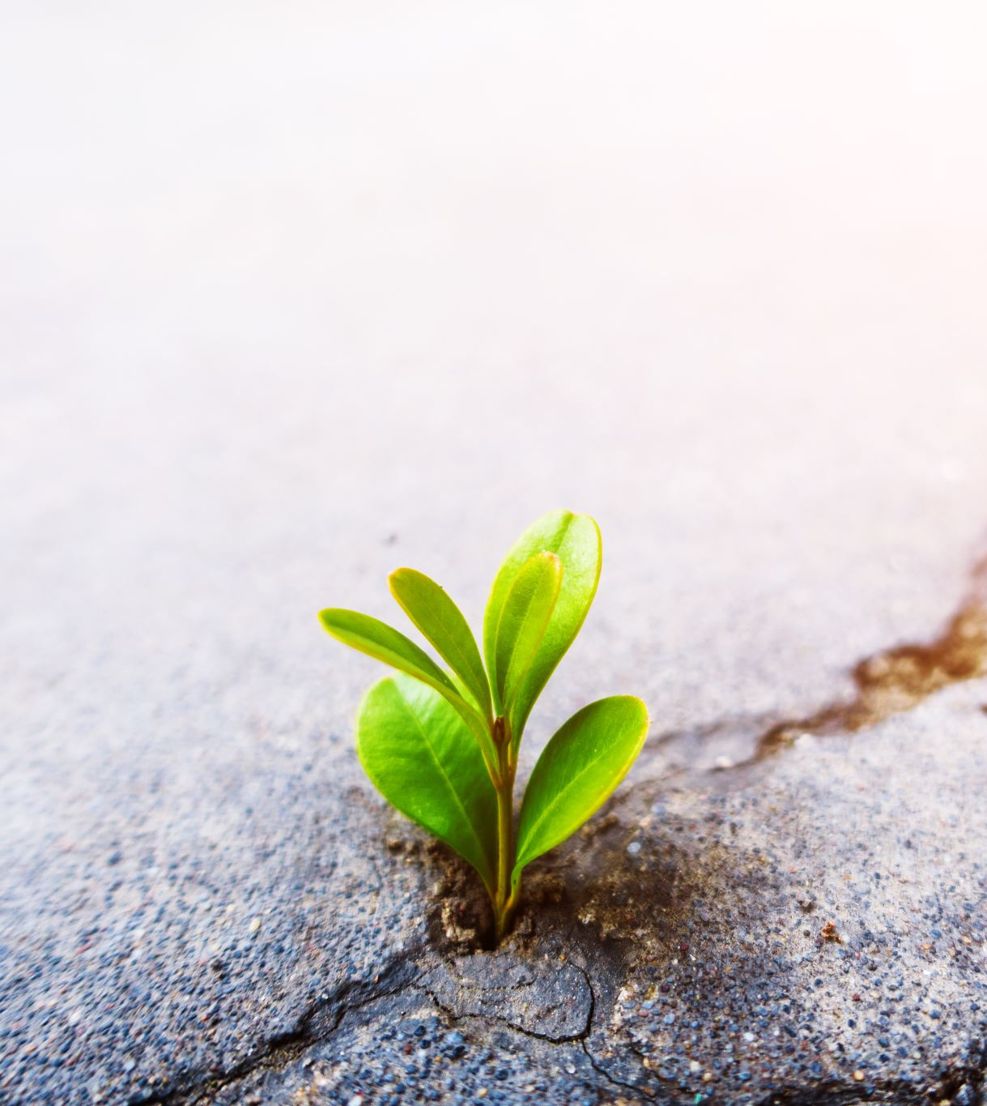
About the Project
A Dynamic 2D animation that shows the four seasons: Summer, Autumn, Winter, Spring and transitions between them like rainfall and snowfall etc.
In this project, we have utilized OpenGL's advanced features to create a stunning visual representation of the season change cycle. From the textures and lighting to the movement of clouds, rain and snow, this project can offer a captivating experience that allows users to appreciate the beauty of nature and the changing of seasons.

Slide 4
Novelty of the Project
The season change cycle simulation can be an educational tool that can help individuals understand the different seasons and the changes that occur in the environment.
The project can have various applications, such as in the field of gaming, where it can be used to create realistic and immersive game environments.
It can also be used in the field of virtual reality, where users can experience the different seasons in a virtual world.
Additionally, the season change cycle simulation can be utilized in the cartoon film industry for creating realistic outdoor scenes that showcase the changing of seasons.
It can also be used by city planners and architects to simulate how the environment changes throughout the year and how different buildings and structures look during different seasons.

Slide 5
Concepts Used
Translation
Rotation
Scaling
Timer Function
GL Library inbuilt Functions
Header Packages

Slide 6
User-defined Functions
Update Functions
Circle Function
Windmill Function
House Function
Rain/Snow Function
Whiteflower Function
Season Functions
Main Function

Slide 7
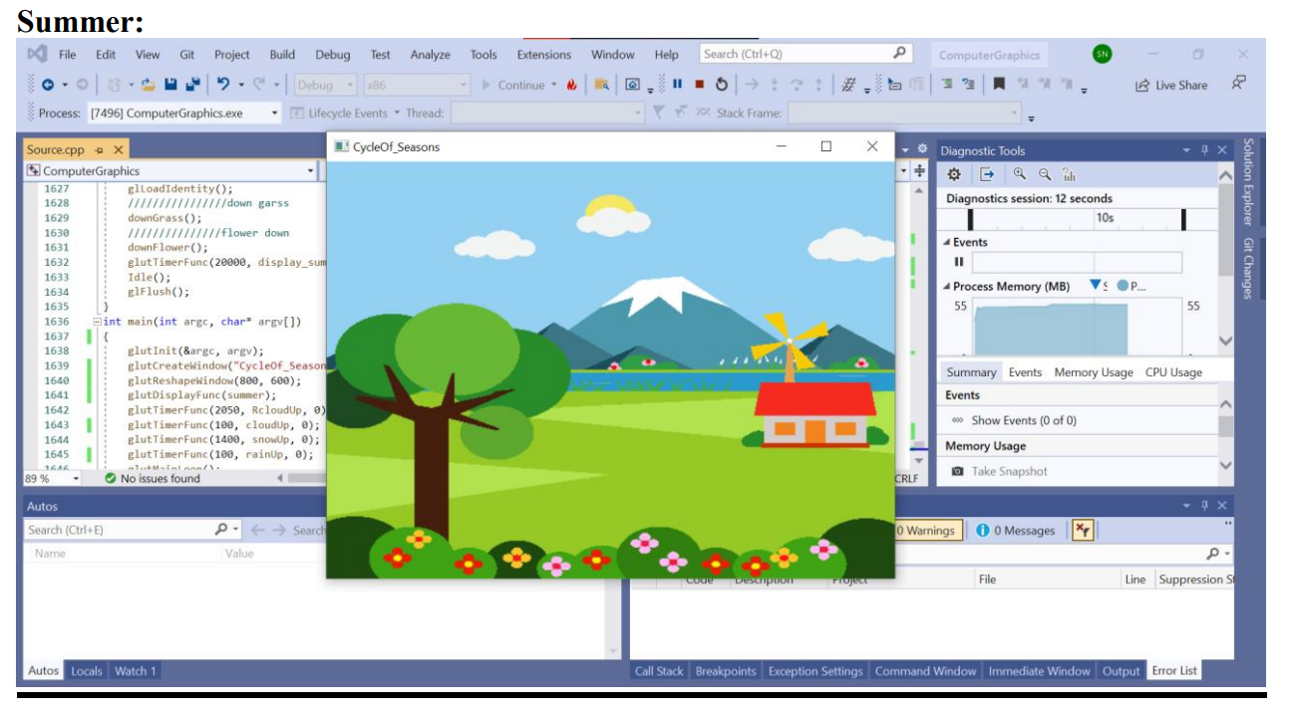
Screenshots

Slide 8
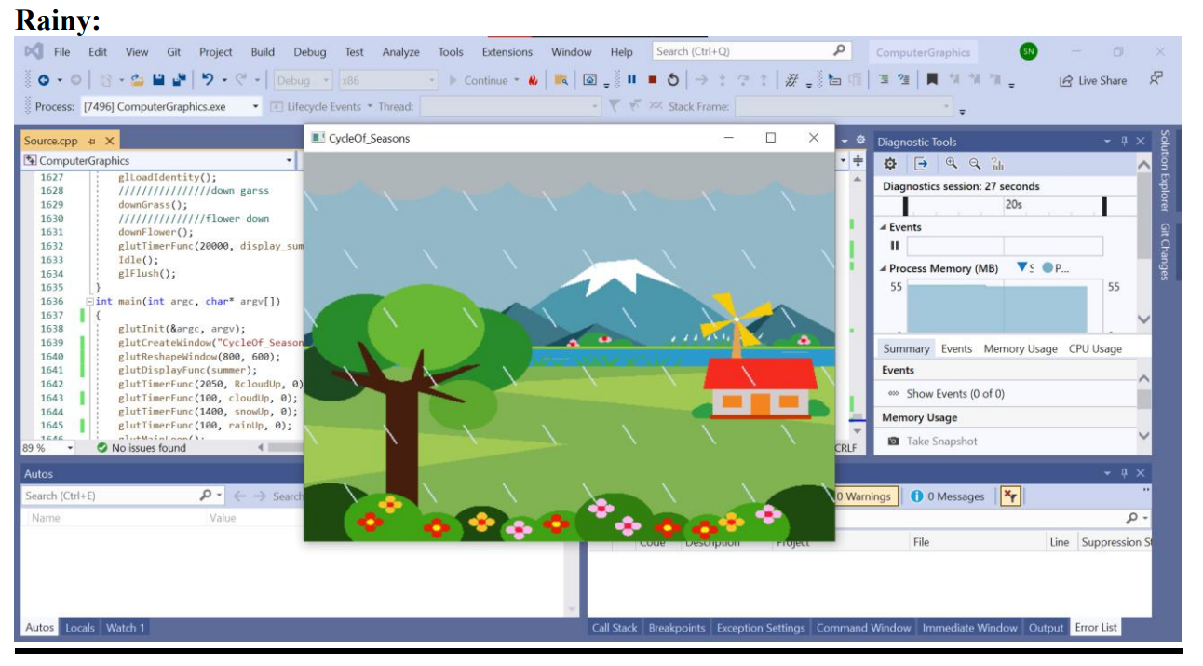
Screenshots

Slide 9
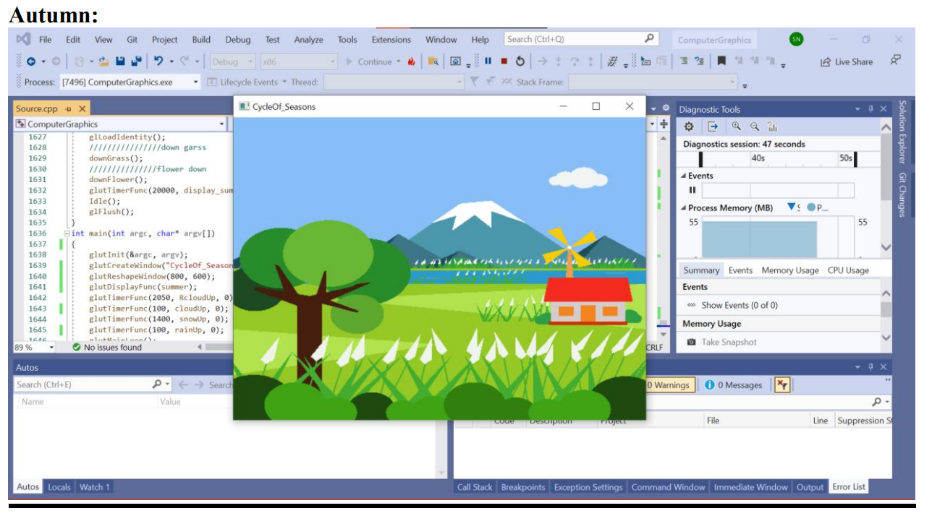
Screenshots

Slide 10
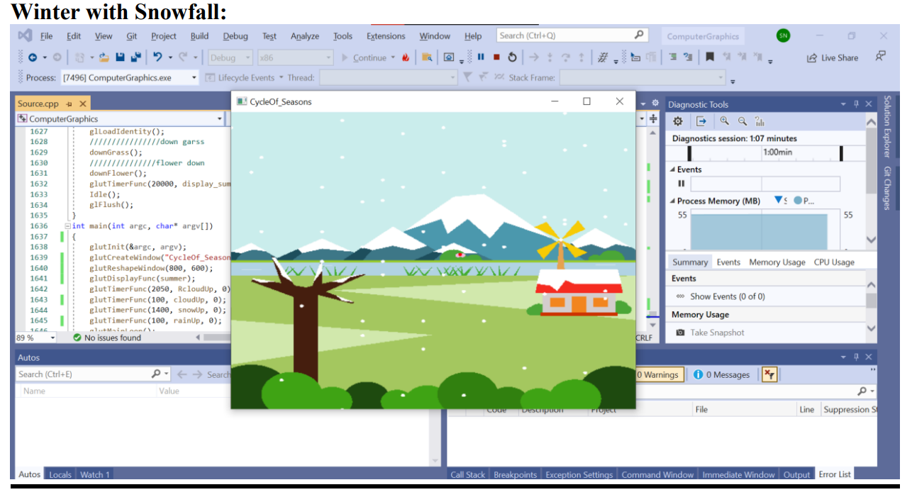
Screenshots

Slide 11
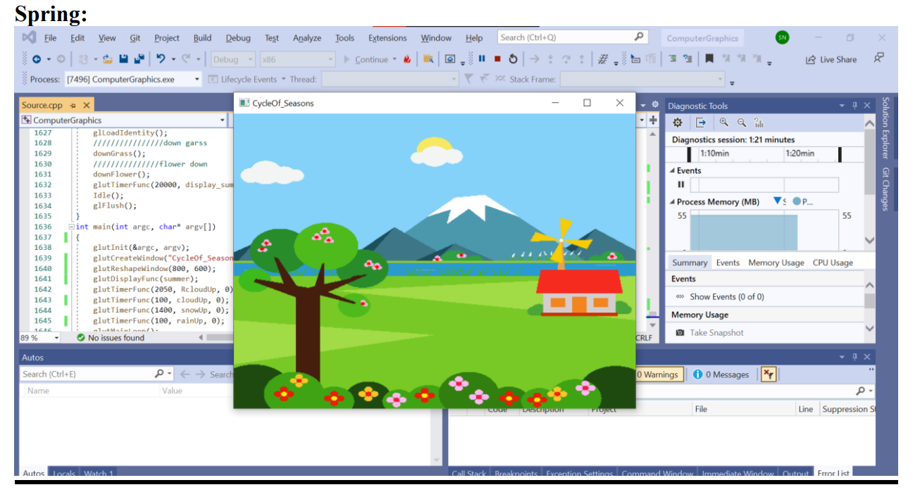
Screenshots

